Slide 1
Volunteering at BLOCK Fest®
Notes:
Hello and welcome to BLOCK Fest!
The Twiga Foundation welcomes you to the Idaho BLOCK Fest® Experience Volunteer Training. We are excited to have you as part of the BLOCK Fest® family and as a participant of this project made possible by Idaho STEM Action Center.
Today we will cover an array of information to introduce you to BLOCK Fest®, inform you of research on block play benefits, walk you through the implementation of a BLOCK Fest® event.
THANK YOU for volunteering for this BLOCK Fest® event! We are excited to have your assistance in bringing this event to the families you serve in your community.
YOU are essential to a successful event. YOU are essential to the Idaho BLOCK Fest® Experience project.
You as a volunteer will be engaging with the participants on the mats at the block stations and will be trained to participate in modeling descriptive language of concepts, promoting parent-child engagement, and scaffolding for children to move to the next level of learning.

Slide 2
What is BLOCK Fest®?
Notes:
BLOCK Fest® was developed by the University of Idaho as a Parents as Teachers Demonstration Project in 2005.
It started out as an idea for creating a parent-child learning event that was research-based.
In the tradition of the University Extension System they looked for a way to take the research to the communities.
At the same time, parent educators were finding families did not have blocks in their homes. they saw blocks as a vehicle for that would provide meaningful experience for broad range of children.
BLOCK Fest® had the generous support of First Lady Patricia Kempthorne and the Governor, as well as financial support from many Idaho businesses to begin its journey throughout the state of Idaho.
BLOCK Fest® is a research-based exhibit looked at research focuses on ages 8 months to 8 years. This hands-on interactive block play experience brings learning and fun to children and their caregivers.
This family interactive event incorporates the entire family, regardless of age

Slide 3
BLOCK Fest® Lingo
BLOCK Fest® Exhibit
BLOCK Fest® Event
BLOCK Fest® Session
Block Station
Block or Mat Facilitator
BLOCK Fest® Host
Orientation Zone
Feedback Card
Notes:
There is some verbiage within BLOCK Fest® I want to explain so the terms make sense as we move through the training.
BLOCK Fest® Exhibit: blocks and all other components needed to facilitate a BLOCK Fest® event
BLOCK Fest® Event: entire set up, facilitation, and disassembly of the BLOCK Fest® Exhibit
BLOCK Fest® Session: a one-hour experience with the BLOCK Fest® Exhibit
Block Station: a designated location for a specific type of block
Block or Mat Facilitator: the person assisting children and adults at the block station during the session
Orientation Zone: the area designated for the participants to wait until the event begins, this space is also where the participants will leave their personal belongings during the event
Feedback Card: an evaluation card for the adult participants to complete during the last block station rotation; they are collected and given to the Host at the end of the event

Slide 4
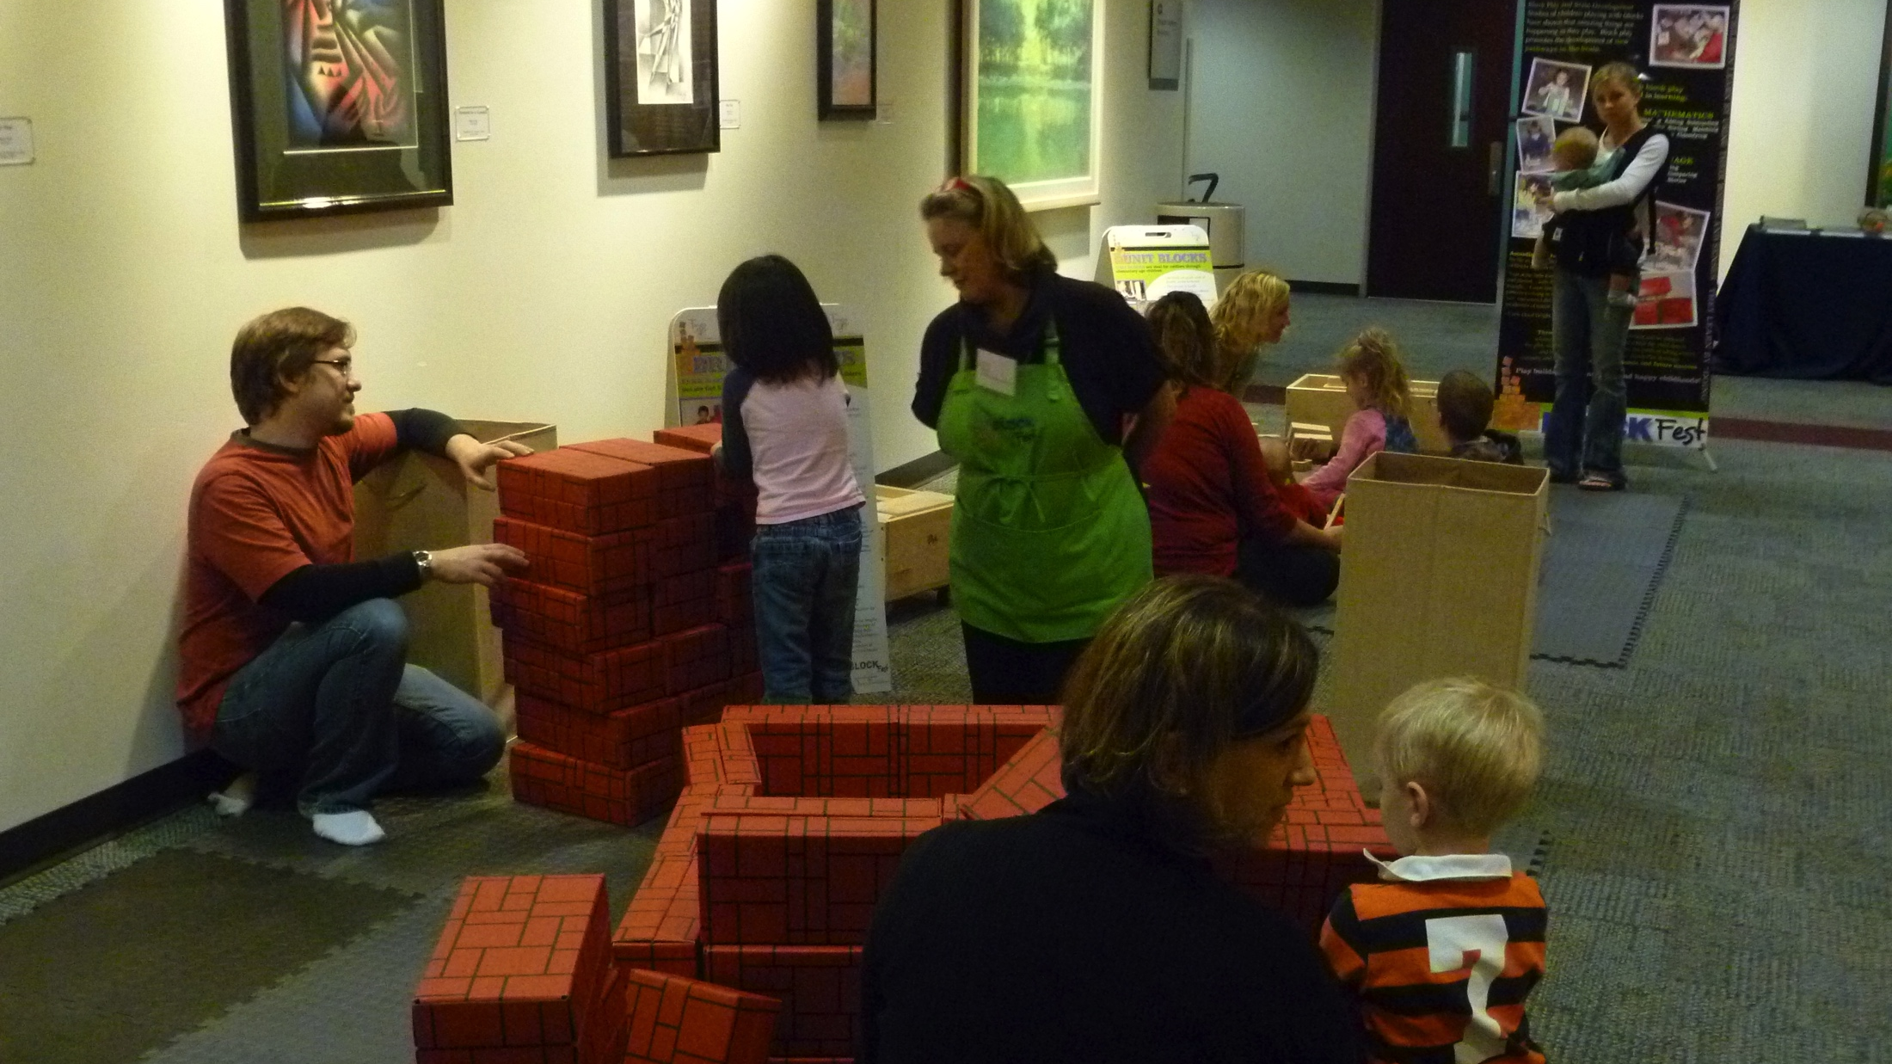
BLOCK Fest® is a one hour experience.
Consists of five stations
10-minutes at each station
Accommodate up to 40 participants: children with parents and caregivers
BLOCK Fest® can be facilitated as several one-hour events
Break between 1 hour sessions is needed
Notes:
BF is a designed to be a 1-hour experience split into five periods providing 10-minutes at each of the five block stations.
At the end of each 10 minute session, time is given to clean-up the current station before moving to the next station.
The five block stations can comfortably accommodate up to 40 participants; this is assuming about 8 per station in a large room. Adding more than 40 participants reduces building space at the block stations. If set-up in a large room, with room around each station, it is possible to increase the capacity, but you also need to consider block count so everyone has enough to create
It can be facilitated for several one-hour events. In fact, try to plan for at least two consecutive event sessions since the exhibit is set up and ready
Allow 15-30 minutes between BF events for volunteers to take a break, and get next group of participants registered and ready to go

Slide 5
Event Guidelines
Not a drop-off event
Station selection
Families stick together
Engagement is encouraged
No Food or Drink
Socks & Blocks
Notes:
Here are the basic guidelines of a BLOCK Fest® event:
BLOCK Fest® is not a drop-off event. Parents & caregivers must accompany their children during the event.
Once BLOCK Fest® begins it will flow easily from one station to the other. Station selection can happen in two ways:
The child gets to choose which station they move to next. The children and families seem to self regulate and we encourage the child to choose their stations. We also encourage them to rotate and try every station.
However, if a child wants to continue creating something they are building, please help them “save” their structure during clean up.
You can also structure the groups and/or rotation. For example, designating certain people to a station and rotating the group clockwise.
During station rotation, the family unit stays together; an adult must accompany their child or children to each station
Encourage the parents and caregivers to get down on the mats to engage and play with their children and to read the banners and signs…they are full of information
Keeping food and drink out of the Exhibit Area helps to preserve the blocks and the mats.
“SOCKS & BLOCKS” is the term used during the event. No shoes or bare feet for safety and sanitary reasons.
During the spring and summer many people do not have socks on. It is possible there will be socks available for people to borrow during the event. The dirty socks are collected after the event, someone washes and returns them to the exhibit.

Slide 6
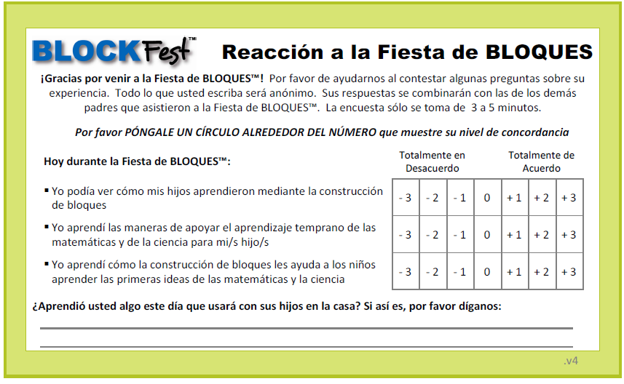
Feedback Cards
Notes:
Getting feedback is an important part of the event so we can improve the implementation of BLOCK Fest® and understand its impact. As well as imperative information for the host organization to evaluate the success of their event. BLOCK Fest® was created based on longitudinal research showing children who participated in block play between the ages of 8 months and 8 years performed better in math and STEM related subjects in high school.
The feedback cards are passed out to all adult participants during the 5th and final station rotation. There are English and Spanish forms available. They are a quick two-sided questionnaire, please encourage every adult participating to complete one.

Slide 7
Registration
Notes:
Pre-registration is highly advised
Explain the registration process for your event to your group

Slide 8
Possible Event Roles
Registration Table
Block Facilitators
Emcee
Floater
Notes:
Volunteers are essential for running a BLOCK Fest® event. At a minimum 7 volunteers are needed for each one-hour session, but ideally 8-10 volunteers allow the event to flow smoothly.
The role of a volunteer can be at the registration table, as a block facilitator, as a floater. The event emcee will be the BLOCK Fest® Host.
We will look at these individual roles more specifically later in the training.

Slide 9
Getting the Event Started
Volunteer Base
Registration
Orientation Zone
Block Stations
Notes:
You are going to need designated spaces for …
Volunteer Base
Registration
Orientation Zone
Block Stations
Let’s look at the purpose of each area and what they will look like.

Slide 10
Volunteer Base
Volunteer Belongings
Secure Location
Easy Access
Notes:
Volunteer Base: You will need a space to put your personal items such as purse, back-pack water bottles, etc.
If you have a secure location, this is ideal. However, under the registration table is a great option; the tablecloth covers from floor to floor and there is usually someone at the table throughout the event.
Try to identify a location with easy access if possible. Often the availability to a water bottle is appreciated.

Slide 11
Registration Area
Participants Sign In
Provide Directions
Answer Questions
Notes:
Registration Area:
As participants arrive, each family will sign in to verify information (on the Attendance Sheet) or provide it (via iPad or computer) and sign for photo release permission, if they didn’t when they registered online.
Direct participants to the orientation zone after registration is complete. Give them instructions to remove shoes, place personal belongings, wait there until given the Orientation Greeting.
This is the also the area most participants will come with questions; we recommend keeping a volunteer posted here at all times throughout the event.

Slide 12
Orientation Zone
Gather Participants
Shoe Removal
Personal Belongings
Waiting Area
Notes:
Orientation Zone:
This is the area to gather children and adults together after everyone is checked in.
Children and parents will remove their shoes and store their personal items.
Encourage them to leave their personal belongings in the orientation zone so they can move easily from station to station. If this area is not within eyesight of the exhibit, position someone to monitor this area the entire time of the event; you want your participants to feel safe leaving their personal belongings.
Ask participants to remain in the Orientation Zone until the emcee gives instructions about getting started.

Slide 13
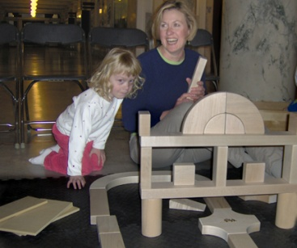
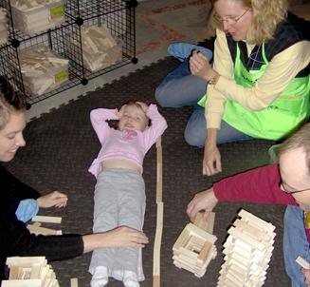
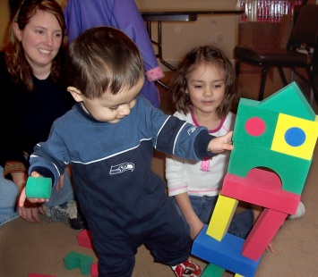
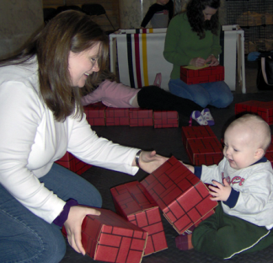
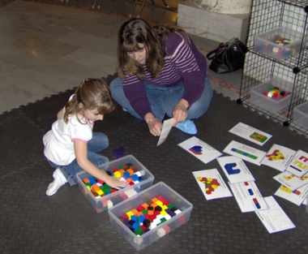
BLOCK PLAY STATIONS
5 different non-interlocking blocks
Unit Blocks
Wooden Planks
Foam Blocks
Brick Blocks
Unit Cubes
Notes:
You will see that BLOCK Fest® has 5 block play stations.
Five different types of blocks were chosen by the development team after considering many different types. We have unit blocks, wooden planks, large and small foam blocks, cardboard brick blocks, and unit cubes or pattern blocks.
The different types of blocks provide a wide variety of types of building experiences, they differ in color, texture, weight and materials.
These are all NON-INTERLOCKING BLOCKS. There are no Legos® or Lincoln Logs ® on purpose. The non-interlocking blocks adapt to any age or skilled child. They also require children to experiment and build in a wide variety of ways.

Slide 14
Resource Cards
“What would happen if…”
“Do you think there are enough…”
“Tell me about…”
“I noticed…”
“I wonder which…”
Notes:
Before we look at setting up the exhibit, let’s look at some of the resources available.
We equip the volunteers with “I wonder” cards in the apron pockets. This handy resource will assist you at the block stations in initiating curiosity and conversation with a child.
For example…
“What would happen if…”
“Do you think there are enough…”
”Tell me a story about…”
“I noticed…”
“I wonder which…”
Asking these open ended questions opens the door for learning, exploration, and imagination.

Slide 15
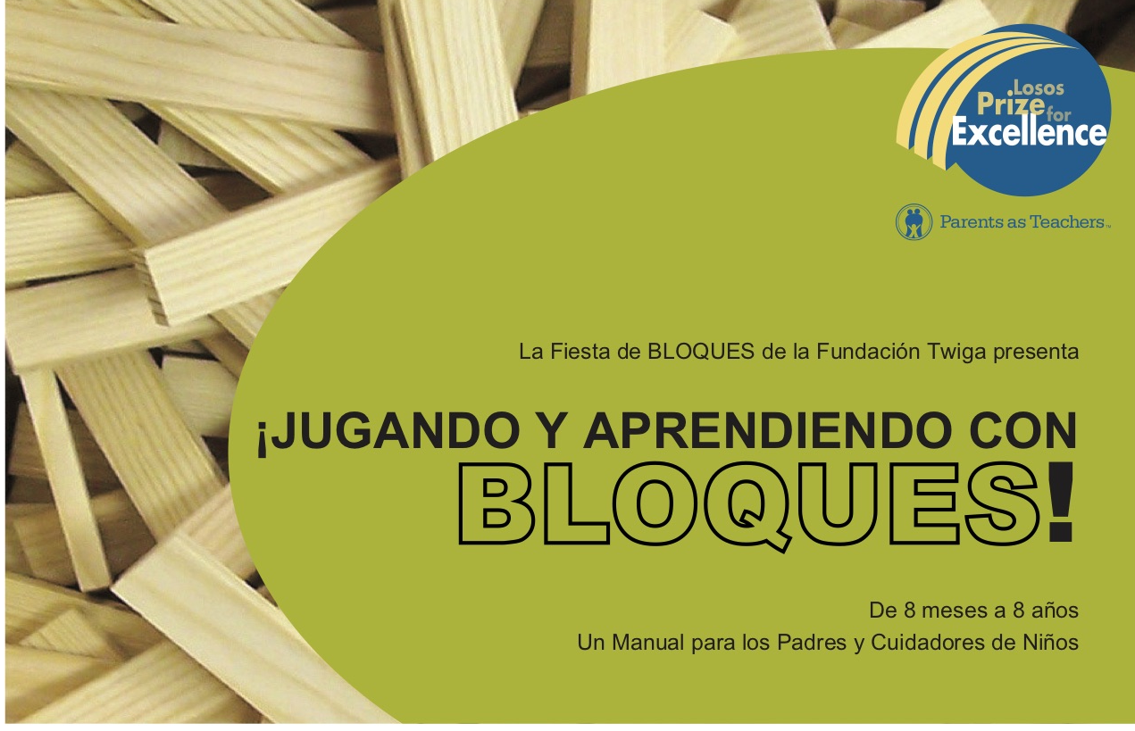
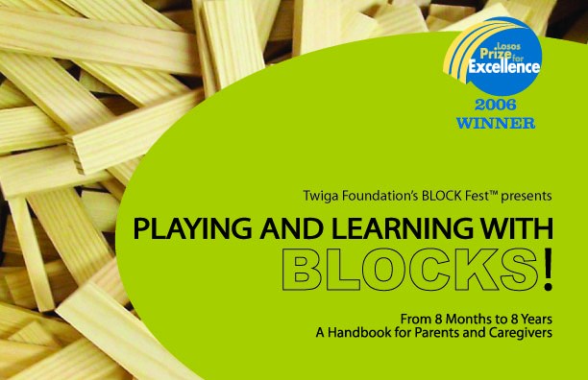
BLOCK Fest® Handbook
Notes:
Another fantastic resource to have available during an event is the BLOCK Fest® handbook. It is a helpful tool for parents and educators.
It provides an explanation of block play, its benefits, and the stages children move through when exposed to blocks.
These developmental charts are a handy reference for adults observing children's block play.
The “Playing and Learning with Blocks” Handbook is an English-Spanish combination book; reading through the book one direction provides the text in English, flipping the book reads through the text in Spanish . It is available in the BLOCK Fest® Store on our website www.blockfest.org.
This resource is often handed out by the hosting organization to families at the closing of an event.

Slide 16
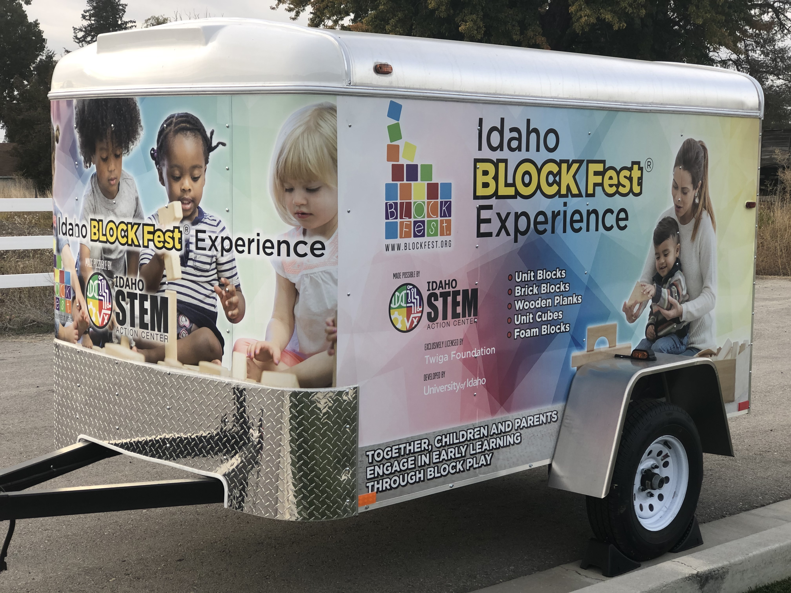
Setting Up Exhibit: Unpacking
Notes:
Your exhibit will be stored in the new BLOCK Fest® trailers. Acquiring a trailer for each exhibit across the state was made possible by the generosity of Idaho STEM Action Center and Trailers Plus in Nampa. We are very excited to make transporting the BLOCK Fest® Exhibit even easier.
The BLOCK Fest® Exhibit comes packed in 23 canvas custom-made transportable bags:
Each bag is labeled with its contents, making disbursement of the bags quick and easy
Unload all BF bags into a general holding area near where you will set up the exhibit
Please do be careful unloading the two Unit Block bags, they are heavy. They have wheels for moving along a flat surface, but the initial lifting will require two people.

Slide 17
Setting Up Exhibit: Open Me First Box
Find First
Exhibit Manual
Tablecloth
Aprons
Forms
Pens
Swiffer
Totes
Notes:
Identify the Open Me First Bag and place at the Registration Table, this box contains additional items for the Exhibit:
You will find the BLOCK Fest® Exhibit Manual. Use this for reference regarding the exhibit and event
tablecloth,
6 aprons,
Forms for registration, photo release forms & stickers, and the feedback forms
Pens or pencils for participants to complete the feedback forms
Swiffer®,
Nested in the bag holding all these components are three empty plastic totes. These totes are used at the large foam block station during clean up.

Slide 18
Setting Up Exhibit: Area Designation
Open Me First Box
Banners
Mats
Block Bags
Notes:
Once you’ve decided on the areas for the Registration, Orientation Zone, and Block Stations, begin placing the bags in their designated spaces.
To the Registration Area, distribute the Open Me First Bag, and the banner bags
There are three bags containing mats. They will need to be distributed in sets of 20 to the location each block station will occupy.
Take the Block Bags to their designated block stations

Slide 19
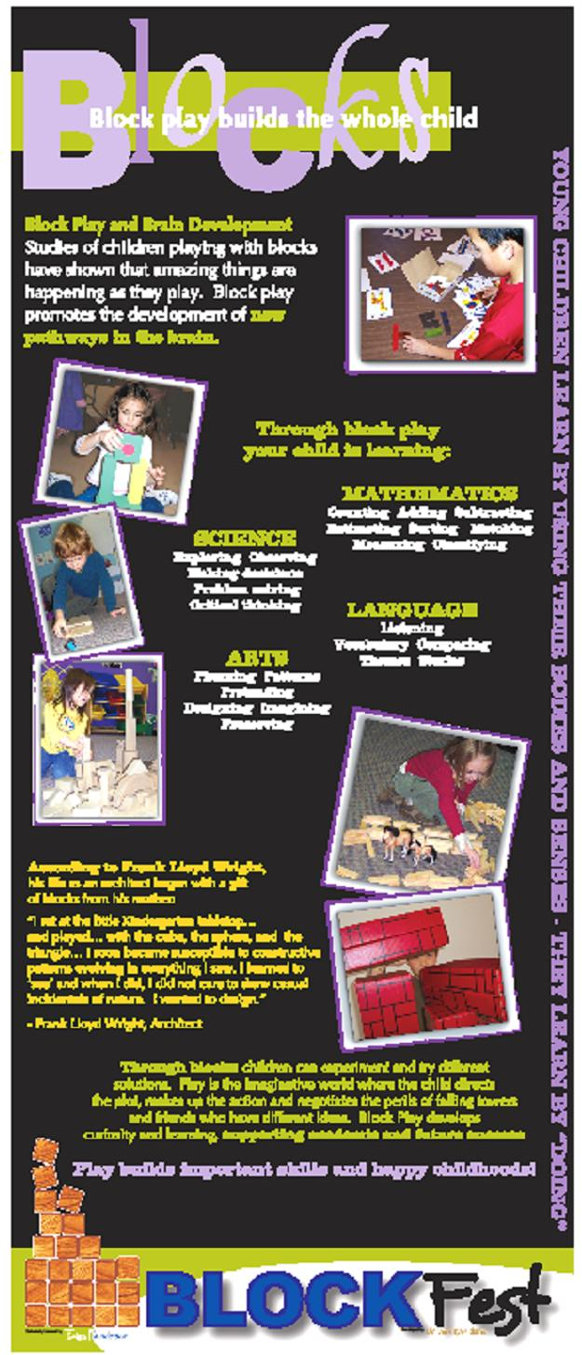
Setting Up Exhibit: Banners
Welcome
Informational
Outdoor Vinyl
Notes:
Two tall veritical banners are designated to Welcome; one in English and one in Spanish
Three tall vertical banners are informational for the caregivers and very beneficial for the volunteers to read prior to the event
Parents as a Child’s First and Most Influential Teacher
Building Math Thinkers
Blocks and the Whole Child
Arrange the informational banners throughout the exhibit area
the orientation zone and the registration area are great places to place them, while people are waiting they should be able to read the information
There is also an outdoor vinyl BLOCK Fest® banner available to use.

Slide 20
Setting Up Exhibit: Station Set Up
Mat Disbursement
Swiffer®
A- Frame
Block Types
Stage Blocks
Bag Storage
Notes:
Lay out mats to create 4x5 mat station, 20 per station (4x5 mats = 8ft X 10ft space requirement)
Swiffer® the mats once they are laid out and BEFORE unloading the blocks at the station
Set up the A-frame for each station in a location that can be read while participants are at the station
Unpack the blocks from the bags. Set up the storage containers, if needed and stage some of the blocks on the mat. Avoid unpacking all the blocks onto the mat, you want to leave room to build.
Once all the bags are unloaded, move them to the designated area for exhibit bag storage.
Often there is a room nearby to place them out of the way.
Some choose to set the bags under the registration table because it is covered by the draping tablecloth, so they are not visible.
We do not recommend keeping them near each station, this can cause the space to feel confined or pose a tripping hazard as participants move from station to station.

Slide 21
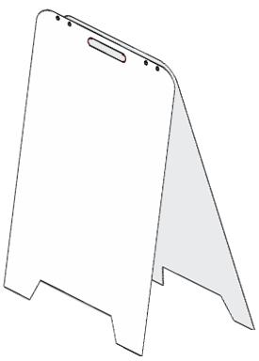
Setting Up Exhibit: A-Frame Set Up
Block Specific Information
Bilingual
Fun Facts
Tips for Parents
Ask the Expert
Notes:
There is a designated A-Frame full of information at each block station.
Each sign is block specific, containing helpful information on each of the five block types.
The A-Frame is designed as a bilingual dual sided sign; one side is English, the other Spanish.
The sign includes items such as fun block facts, tips for parents, and an ’ask the expert’ section.
These are a valuable resource to the adult participants and designed to be read at floor level….be sure to read them!

Slide 22
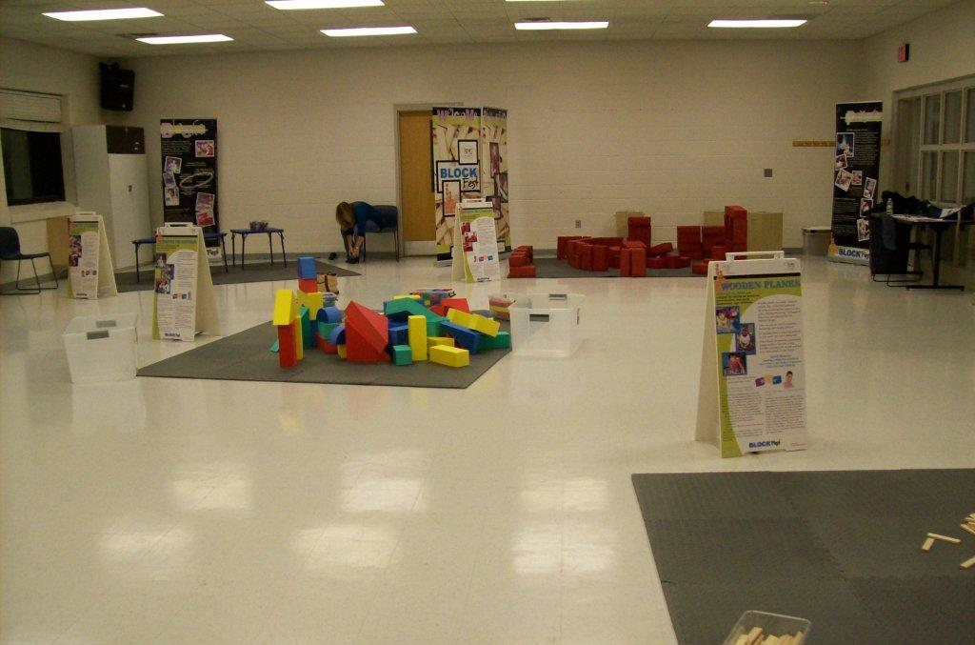
Block Stations
Foam Blocks
Cardboard Brick Blocks
Unit Cubes
Wooden Planks
Unit Blocks
Notes:
As you look around, you’ll see we have 5 distinct play areas or stations defined by 5 matted areas.
The mats provide a visual space for each station.
They also provide a solid surface for building while being comfortable for sitting on the floor so parents and children are able to play on the floor together.
The mats are non-allergenic, latex free, easy to care for, durable, and travel well.
The configuration of the mats can be flexible depending on how large the venue space is to set up the BLOCK Fest exhibit
There are containers at each station. The containers help transport the blocks and organize each station, they also provide an opportunity to practice cleaning up. By cleaning up after play we give the next child a chance to begin building with a blank slate.

Slide 23
Station Rotation
10 Minutes at each block station
Emcee signals Clean-Up time
Group rotates simultaneously
Child chooses next station
Families stick together
Notes:
Station rotation occurs after every 10 minutes of block play
The Emcee will signal the group to clean up, a microphone is helpful get the group’s attention
The large group waits until each block station is picked up. Once each station is clean, the group rotates stations at the same time
The children are encouraged to choose their next block station, but remind families to stay together

Slide 24
Station Clean Up
Learning & Fun
Clean Slate
Encourage New Station
Notes:
Encourage children and parents to make clean-up part of the learning and play experience.
Clean up can incorporate learning…Think of some ways you can prompt that: clean-up by sorting, find all the red ones, how many fit in one handful? How fast can you clean-up?
Encourage children to try the next station but allow for imagining to continue if the child is determined to continue their creation and remember to help “save” a structure from “helpful friends” during clean-up time

Slide 25
Feedback Cards
Notes:
Remember these?
The feedback cards are passed out during the 5th and final station rotation.
Please encourage every adult participating to complete one; each person has their own experience and perspective.
Distributing the cards before the 5th rotation starts can be done by the Block Facilitators, the emcee, the floater if you have one.
Collection of the cards can be done by the Block Facilitators, the floaters, the emcee, or returned to the Registration Table. The Emcee will explain to the participants on when to fill them out and instruct them on what to do with them upon completion based on the best option for your group or venue.
The host facilitating the event is responsible to collect the forms and get them submitted to Twiga after the event.
Let’s go ahead and circle back to the volunteer roles now that you have an idea of what the BLOCK Fest® Exhibit will look like look…

Slide 26
Possible Event Roles
Block Facilitators
Emcee
Floater
Registration Table
Notes:
Roles to fill are at the Registration Table, as Block Facilitators, Floaters, and as the Emcee

Slide 27
Emcee:
Greets Participants
Orientation Greeting
Timekeeper
Signals Clean-up & Rotation
Supports Areas
Feedback Card Collection
Closes Event
Notes:
EMCEE: This person facilitates the event. They are a trained BLOCK Fest® Host, with BLOCK Fest® experience.
If the Emcee does not have previous experience with a BLOCK Fest® but has completed the BLOCK Fest® training, talk through the Emcee duties with a representative from Twiga.
The Emcee…
Greets the group and provides them with the orientation greeting
Explains information about the flow of the event and gives the guidelines to follow
Keeps track of time for the event and each rotation
Signals clean-up and rotation time to the group
Supports the mat facilitators and registration table (designates floaters to needed areas)
Ensures the participants are given the Feedback Cards at the fifth rotation and the cards are collected and submitted
They close out the event , direct participants back to the Orientation Zone, and thank everyone for coming.

Slide 28
Registration:
Greeting
Direct Participants
Sign In
Form Completion
Answering Questions
Notes:
Having two people stationed at the registration table will allow for a smoother process getting your participants ready to go.
A volunteer at the Registration Table will greet the participants and sign them in. They will also answer any questions and guide participants to the orientation zone with instructions on how to prepare for the event to begin.
After participants are signed in, the volunteer will instruct them to go to the Orientation Zone, place their personal belongings, and remove their shoes.
Volunteers will provide the participants with the required forms for the event:
the sign in sheet – print the Attendance Sheet from the Host event access in the app. There are printed registration sheets if needed for drop-ins to document before they fill out the online registration.
Participants can use the iPad with the app or any device and go to www.block-fest.herokuapp.com to begin registration.
2) the photo release information - this indicates the parent/guardians permission on whether or not they will allow their child to be photographed or videoed. These images can be taken by Twiga Foundation, the hosting organization, and any other participant. When a child is NOT to be photographed, the Registration Volunteers will provide them with a sticker to place on the front and back of the child. Photo Release information is addressed in the Emcee’s Orientation Speech before the event begins.
The registration table will also answer most of the inquiries from the participants

Slide 29
Block Facilitator:
Block Station Helper
Parent-Child Engagement
Scaffold
Model
Descriptive Language
Practical Communication
Refresh Station
Notes:
BLOCK FACILIATORS are volunteers who are stationed at each of the block stations.
They help engage the parent & child in play, ask “I wonder” questions to help scaffold learning, identify concepts the children are building and explain them (for example, pointing out parallel or symmetry in their structure), and use terminology for math, science, or art.
A minimum of 5 people are needed for block facilitators; one at each block station. Begin by selecting a block station that looks interesting to you. Get familiar with the blocks, their attributes, and read the A-frame of information. Stage some of the blocks to peak the curiosity of the children as they begin the event and select their station.
You are a resource for the parents and the children – encourage parent-child engagement while families are at your station. Utilize the “I Wonder Cards”, demonstrate modeling, as well as use descriptive language in your conversations. We will cover each of these tools and how to incorporate them as we move through the training.
When you are on the mat, practice and model practical communication efforts. Get at the child’s eye level, help children join in, encourage clean up, help children share or notice when they do.
In between events, the block facilitator will also refresh the block station to stage it for the next group.

Slide 30
Floater:
Extra Hands
Assist where needed
Notes:
FLOATERS: These are extra volunteers who assist wherever needed…welcoming participants, guide families to the orientation zone, help keep participants in orientation zone before event begins, and monitor the personal items in the area, if they are being kept out of view during the event. Floaters will also sanitize those blocks the littles have sampled and tasted and have them ready for the next station rotation. They can also be available to move into block stations where more children have accumulated to support the block facilitator with engaging the children and adults.

Slide 31
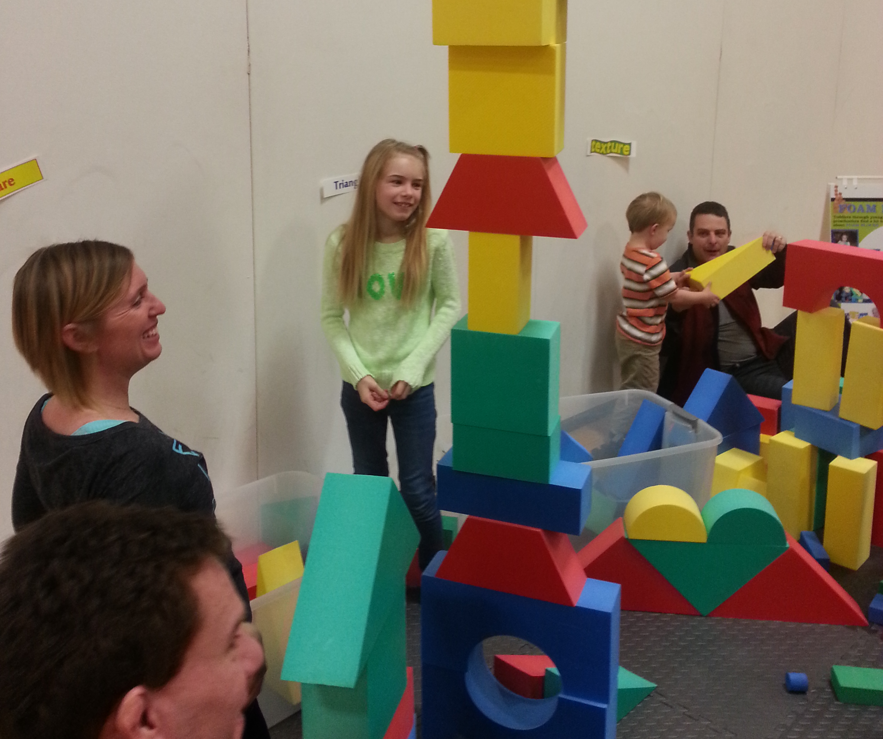
Block Facilitation

Slide 32
STAGES OF BLOCK PLAY
Notes:
Scaffolding, modeling, and usage of descriptive language are big parts of the BLOCK Fest® experience facilitated by the Block Facilitators.
This video gives a brief overview of the 8 Stages of Block Play, helps to recognize the various stages, explains moving through the stages is a natural progression increasing in complexity as the child spends more time playing with blocks, and will help prepare you as a Block Facilitator in assisting a child to move from one stage into another.

Slide 33
Block Facilitation: Scaffolding
LAUNCH
children and parents to the next stage
Notes:
Scaffold for the children and parents to help children try that next stage
Lets look at what this means…

Slide 34
Block Facilitation: Block Language
Math Words
Science Words
Art Words
Language Starters
Naming Discoveries
Notes:
They use the language of math and science to describe the play and discoveries of the children.
Math words…Count, Add, Order, Long, Square, Line
Science words…heavy, balance, weight, hypothesis, after
Art words…pattern, color, motion, bright
They encourage language by introducing vocabulary and inquiring about the structure the child is building.
Help children make discoveries by Identifying concepts you see them creating and using, give an explanation and a definition

Slide 35
Block Facilitation: Modeling
Feedback
Descriptive Language
Open Ended Questions
Discoveries
Practical Skills
Notes:
Model- facilitators are constantly modeling feedback, descriptive language, open ended questions and naming discoveries. They also model some very practical skills like sitting with the children, communicating at eye level, helping children join, helping children have fun cleaning up and helping children share.

Slide 36
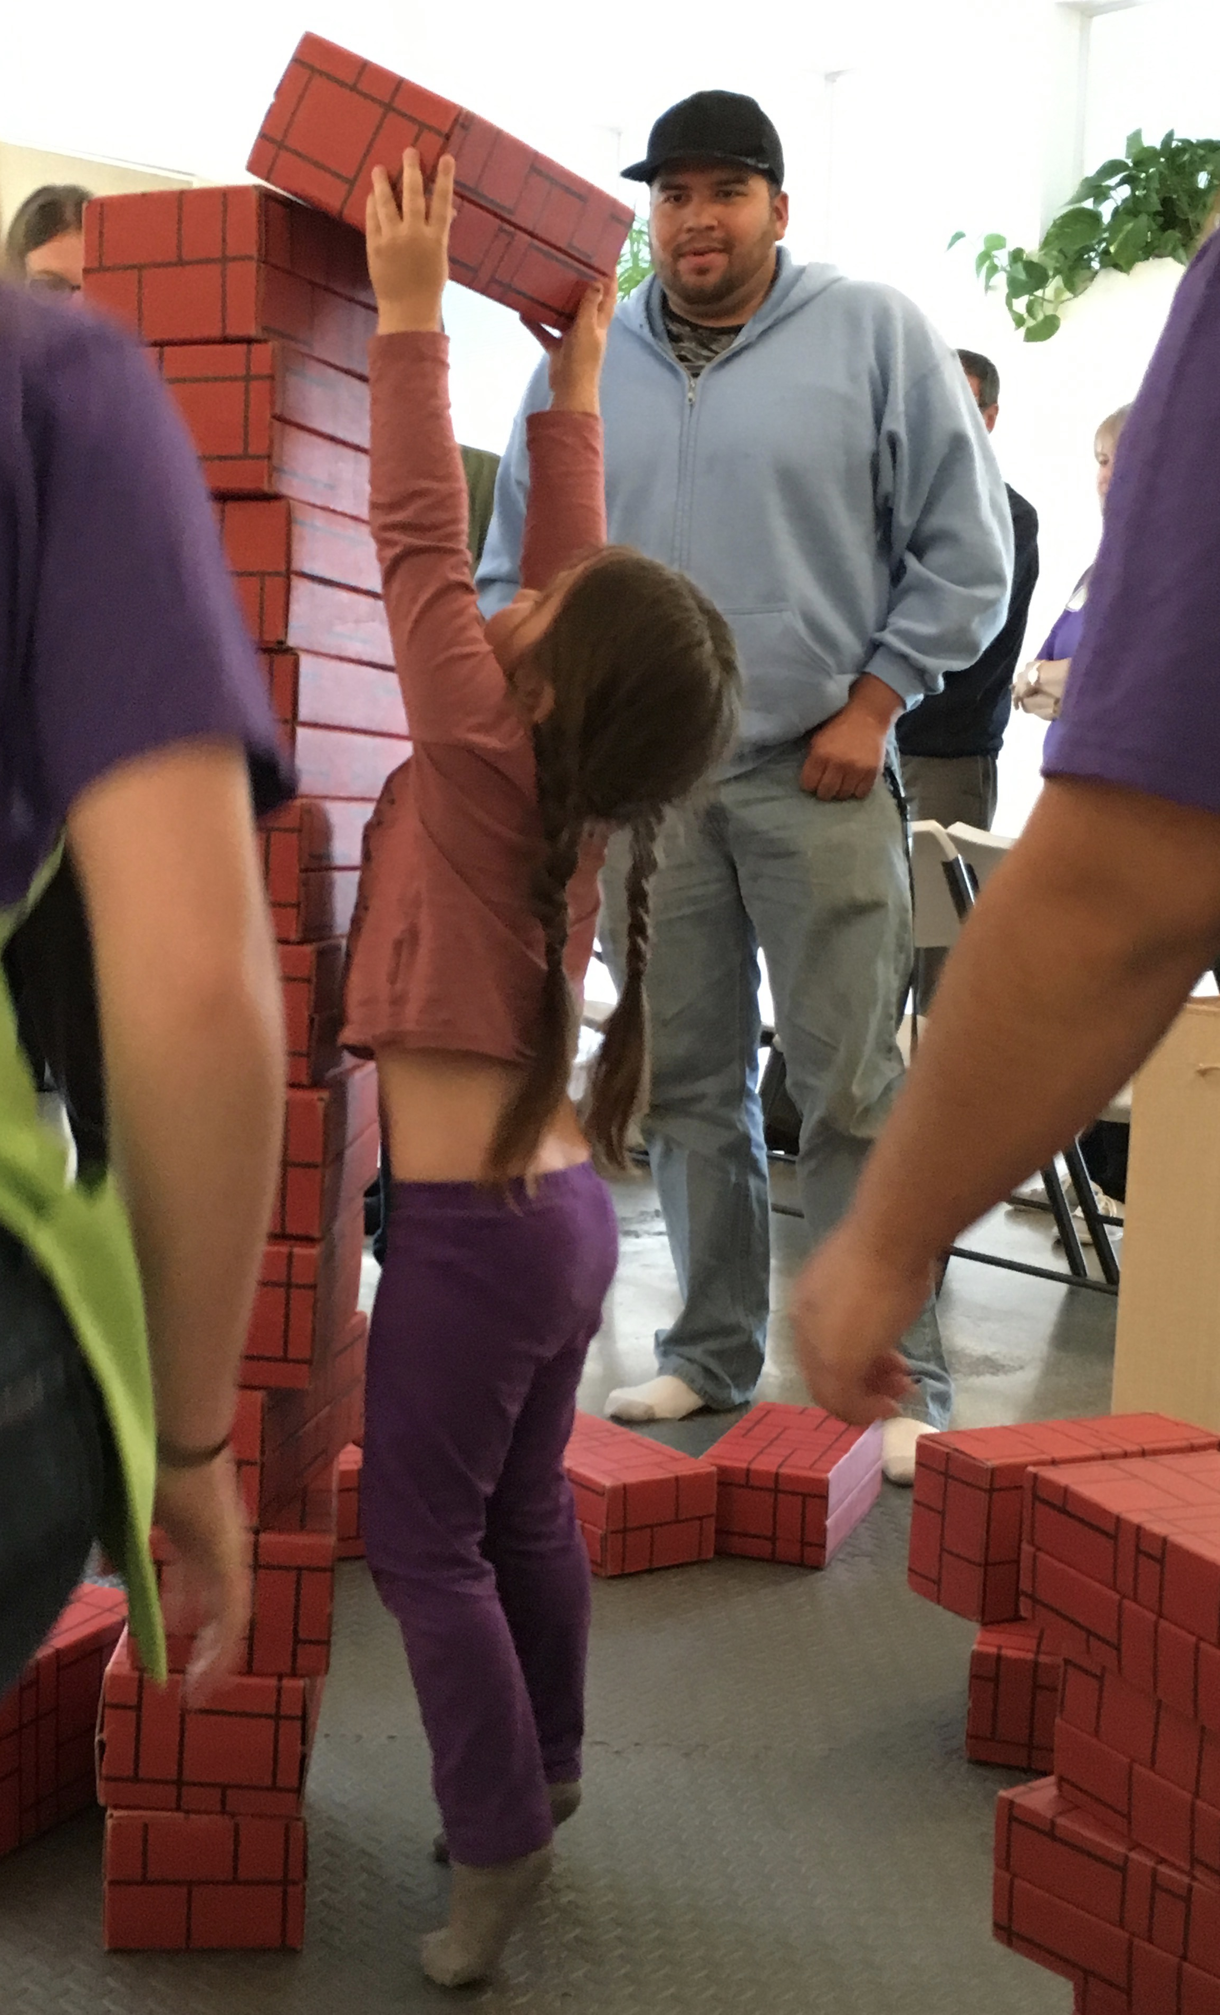
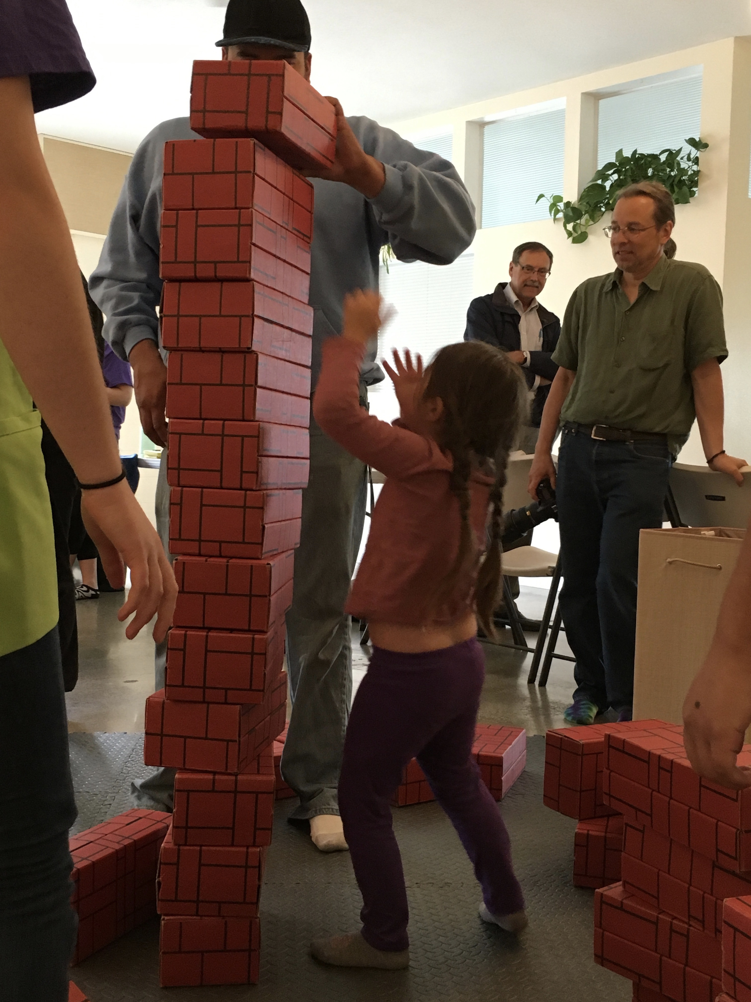
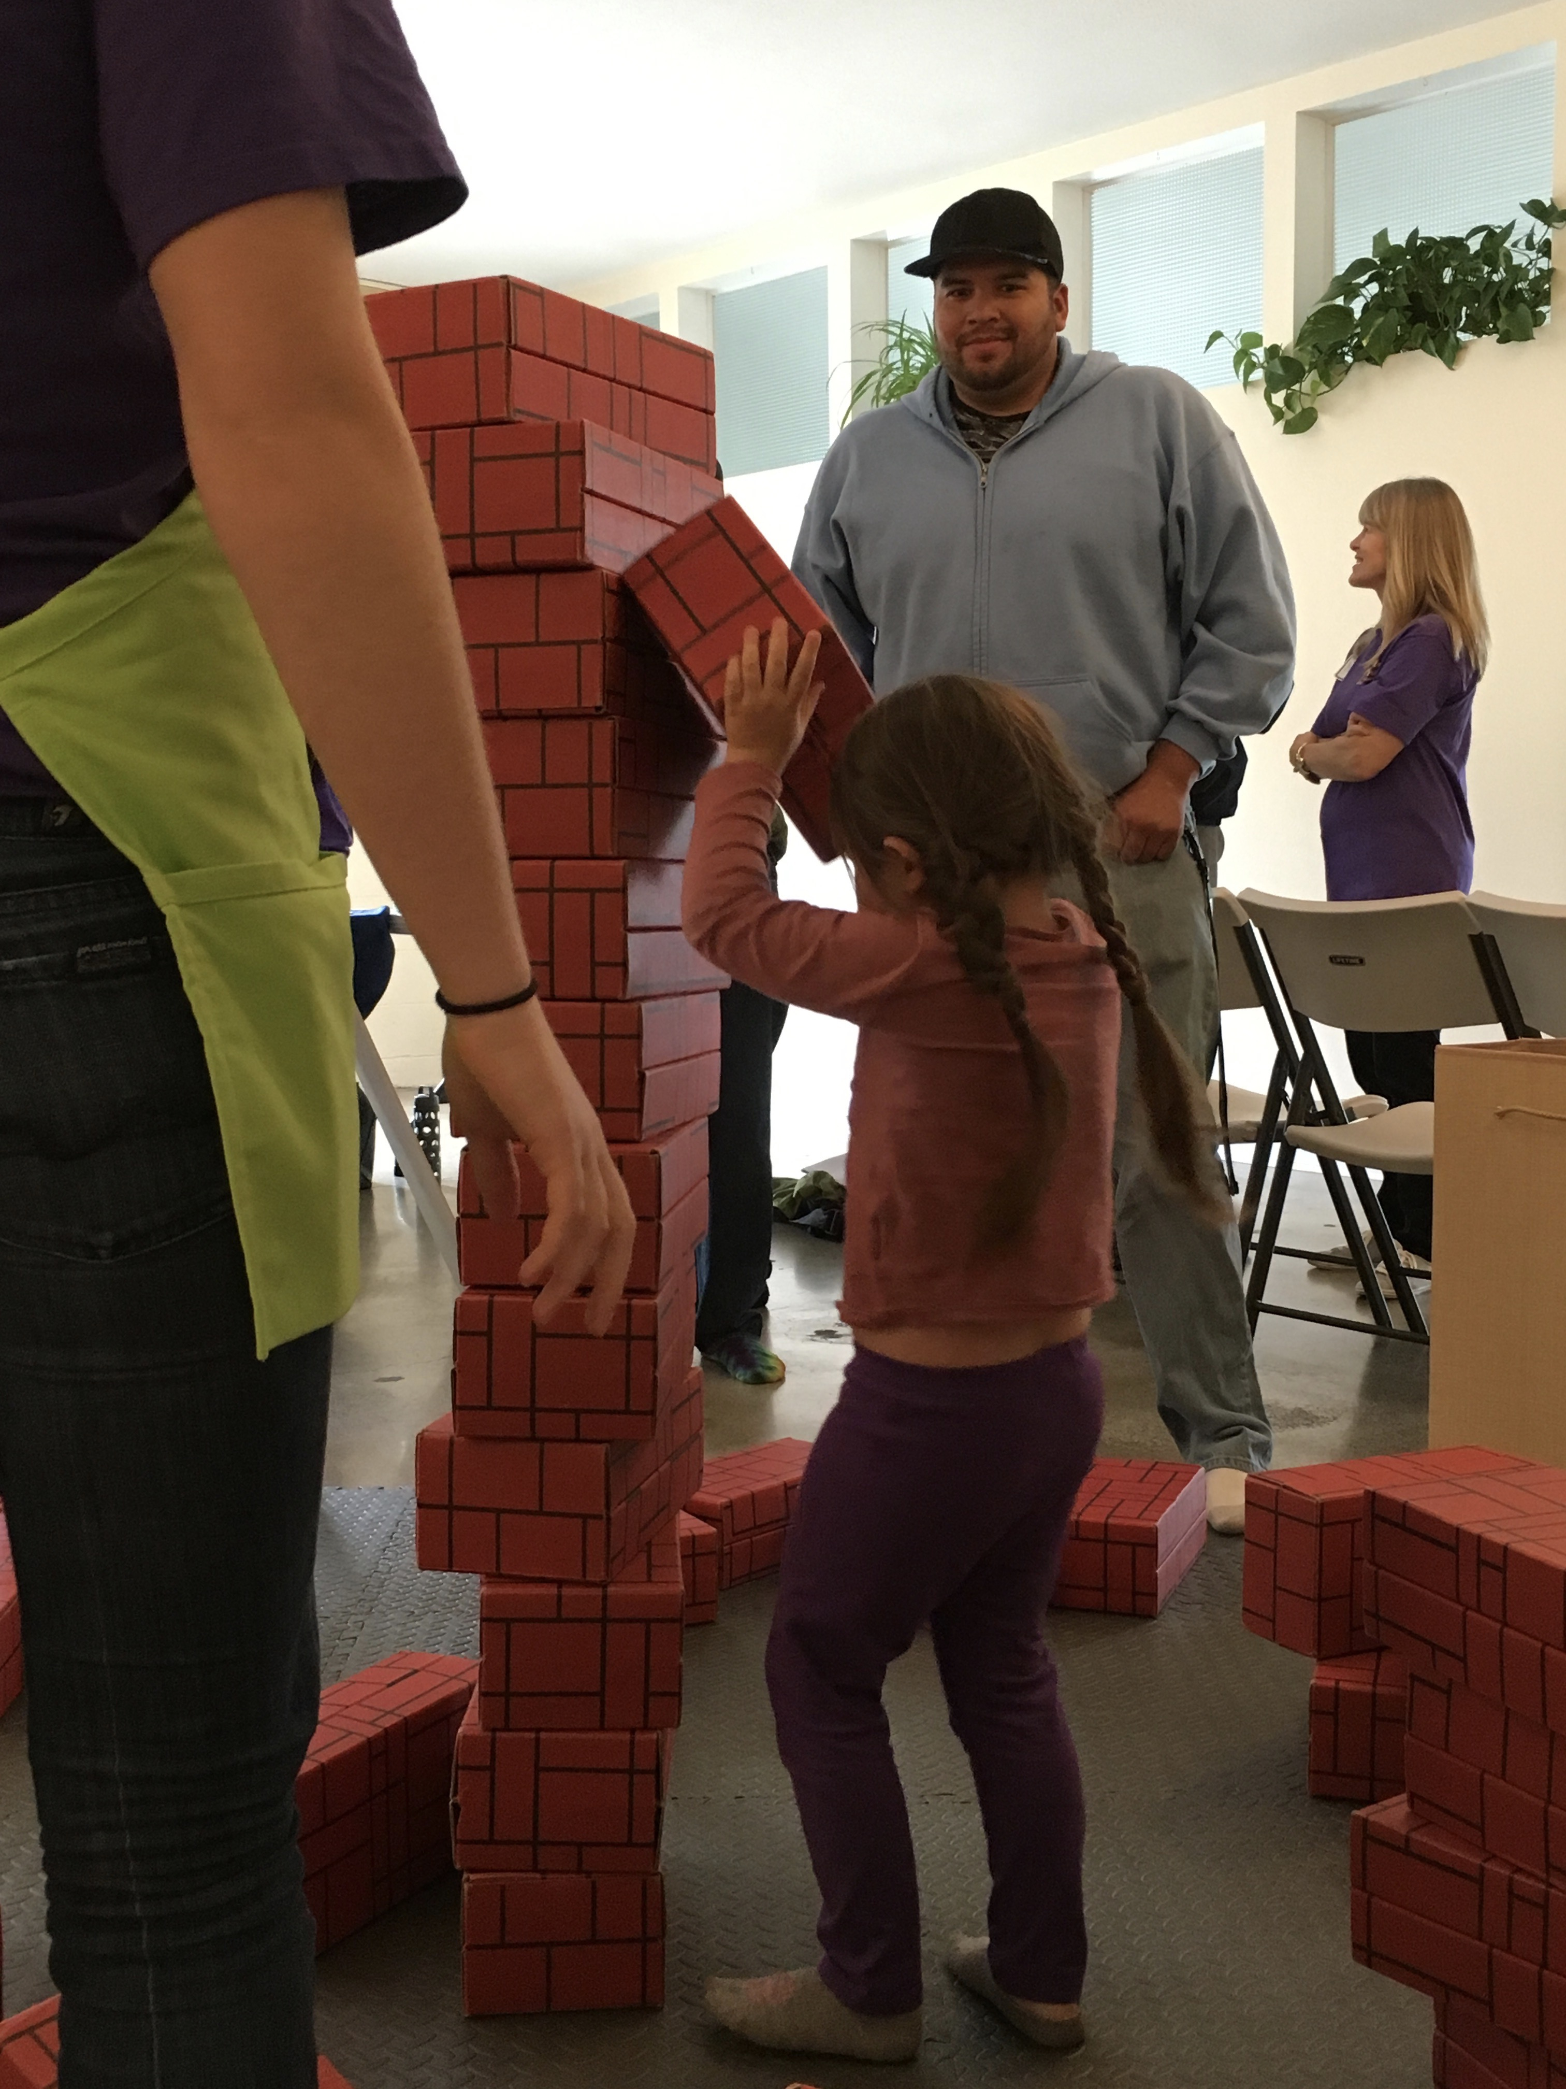
What do you see?
Notes:
What do you see happening in these images?
Which stage do you see in these images?

Slide 37
Share your findings…
Notes:
These images represent a progression of stacking.
This child demonstrates the continuation of vertical stacking and fortitude as she pushes to stack the boxes as high as possible, eventually recruiting some help from dad.
Think about the possibility of learning that might have occurred in this scenario.
Think about how you as the facilitator could engage in this building process.

Slide 38
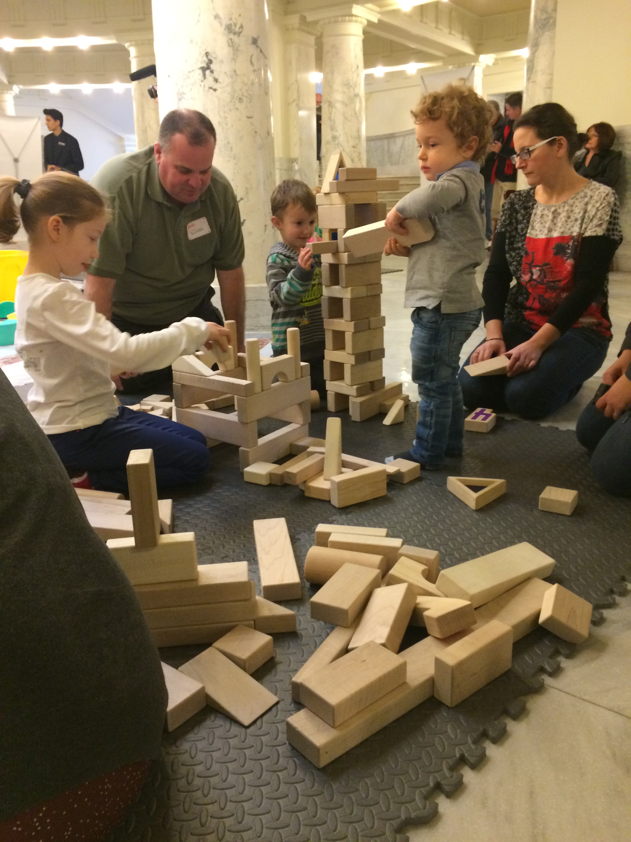
which stage do you see?
Notes:
Can you identify the some of the stages of block play represented here in these two structures?

Slide 39
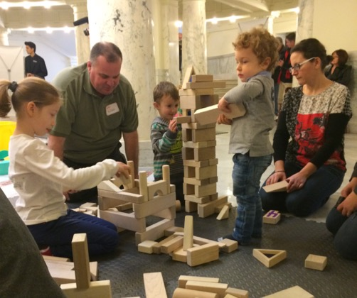
Share your findings…
Stage 4
Stage 7
Other Stages?
Notes:
We see a number of stages represented here.
Did you identify stage 4? Did you move stage 4 right into stage 6, combing enclosures and bridges?
Do you see stage 7? Building with patterns and symmetry in the taller structure.
Did you identify the DISCOVERY happening as the little boy is sliding the block through the center of the structure?
Let’s look at some of the stages you identified.

Slide 40
Adult Role: Engagement
Participate on the Mats
Read A-Frames
Encourage all stations
Encourage modeling & descriptive language
Notes:
Yes, even the parents and caregivers have a role during BLOCK Fest®.
Encourage adults to sit down and play along side their child, block play is a fun activity for families to participate in together, regardless of age
Reading the information on the A-Frames at each station will equip the adults with information they can share with their child.
Adults should help their child track the stations they’ve participated in, encourage them to visit each station , and be ready to help clean up and try the next station.
The Block Facilitators have direct contact with the parents and children. Encourage adults to engage and give them hints on how to communicate with math language and give encouragement to the block play experience with their children. Remind them they can incorporate STEAM components into their child’s everyday activities.

Slide 41
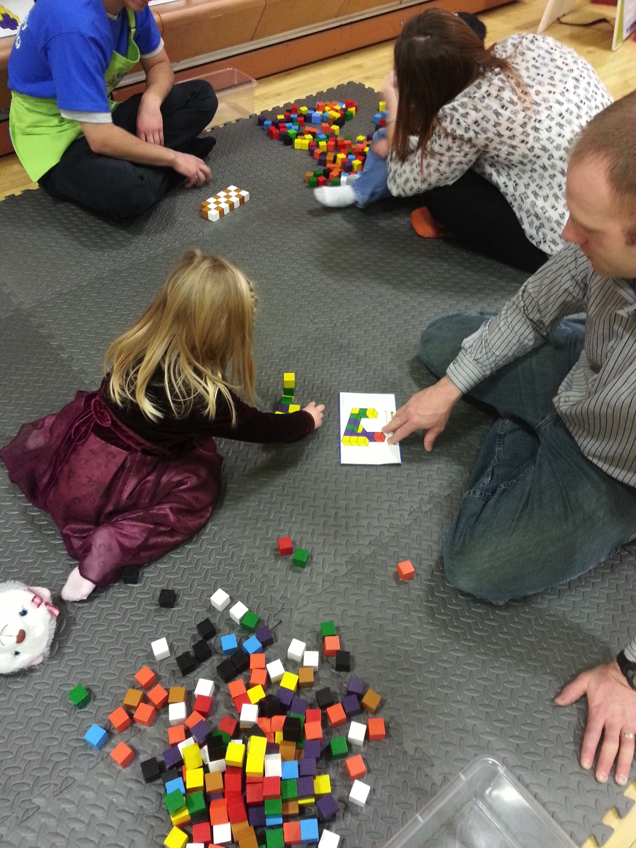
Children’s Role
Initiate
Have FUN
Learning
Sharing
Exploring
Notes:
The children jump right in and show us how it is done!!!
They ENJOY every minute.
Children are open to math & science learning a very early age. Blocks provide the hands-on learning for many math and science concepts.
Parents can facilitate learning by playing along with their children, modeling, verbalizing and extending their knowledge. They will soak in the BLOCK Fest® experience as they create, build, learn, sharing and play with others and explore new concepts.
It is good to remember in a group environment like this, children may choose to work alone or with other children; they choose which they are comfortable with, the adults can help facilitate their choice.

Slide 42
Between Events
Volunteer Break
Sanitize Blocks
Refresh Blocks
Notes:
If more than one event is scheduled the 15- 30 minutes in between can be used to give the volunteers a quick break, sanitize any blocks, and refresh the block stations with another block staging.

Slide 43
Packing Up Exhibit
Retrieve Bags
Sanitize Blocks
Pack up blocks
Swiffer Mats
Repack ‘Open Me First’ Box
Load Exhibit
Turn in Feedback Forms
Notes:
Once the event has ended, retrieve the bags and deliver each one to the appropriate station or location.
Identify any blocks needing sanitized
Pack up the blocks in the designated bins, boxes, and bags.
Swiffer the mats before disassembling and packing away.
Return the plastic totes from the foam block station to the ‘Open Me First’ bag and pack up the registration contents
Load the bags back into the trailer
Verify the Feedback Cards have all been collected and given to the BLOCK Fest® Host for submission to the Twiga Foundation

Slide 44
Reminders
Socks and Blocks
No drop-offs
Read banners and signs
Encourage adults to read information banners
Feedback Card
Notes:
Always “Socks and Blocks”
Children must be accompanied by an adult, no drop-offs at the event
Read the banners and signs to familiarize yourself with block play and the block types
Encourage the adult participants to do the same by reading the material provided at the event.
Feedback cards are handed out during the fifth rotation, encourage adults to complete them and remember to collect them.

Slide 45
Volunteer Arrival
Notes:
When you arrive the day of the event…
Sign in, having a reference list can be helpful if you need to identify the volunteers who attended at a later date, especially if they seek BLOCK Fest® Host Training Certification
Put on a name tag, they should be provided with the exhibit or wear your personal name badge associated with your agency
Grab an apron; the volunteers participating as block facilitators are given a green BLOCK Fest® apron like those shown in the photo
Wear your apron, the pockets will hold materials needed during the event, such as…
I Wonder Cards
Feedback Cards
Pencils or Pens
‘Playing and Learning with Blocks’ Handbook
Know where the restrooms, drinking fountains, and exits are located in your venue
Remember to use descriptive language and HAVE FUN!

Slide 46
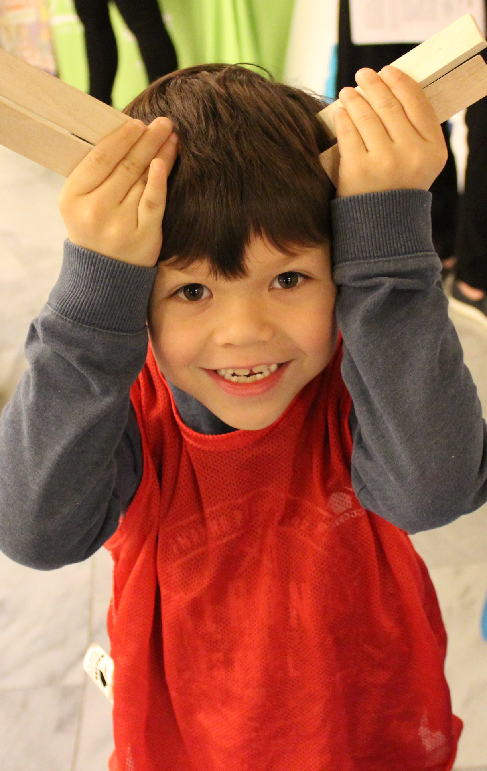
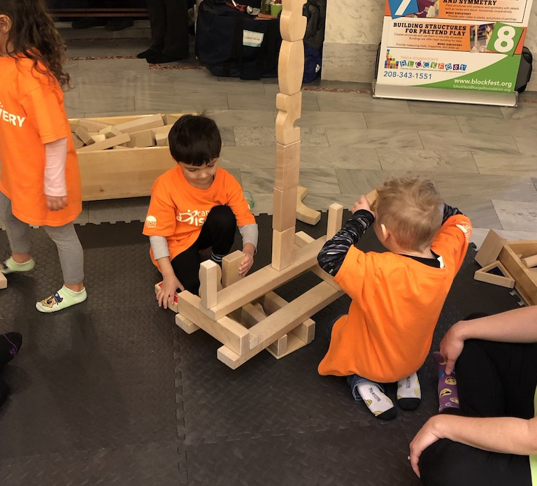
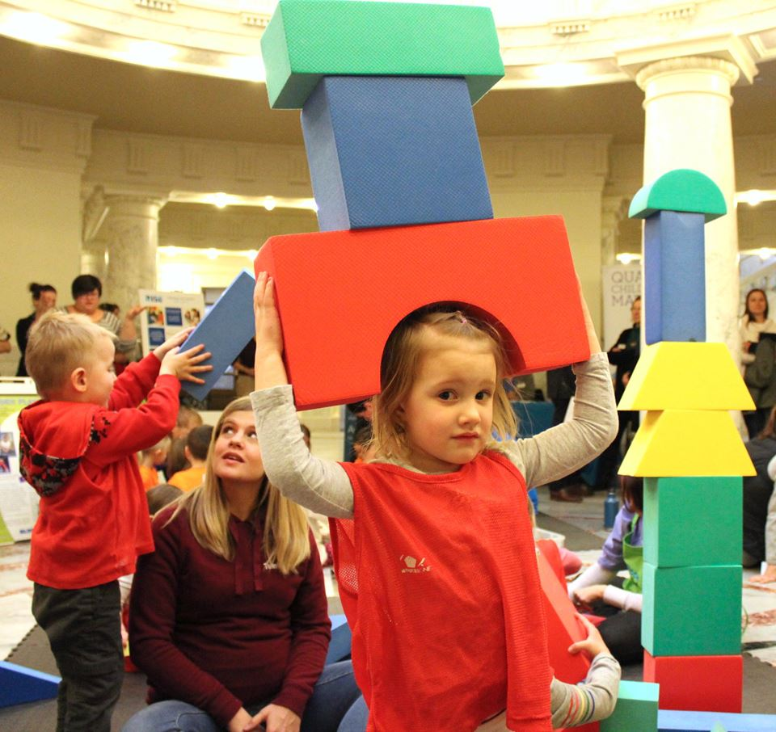
Ready
for
FUN
Notes:
You will learn quickly that BLOCK Fest® was designed to be set up and taken down quickly and easily transported to the next event.
Each BLOCK Fest® event will give you an opportunity to practice what you have learned.
No one can describe the dynamics and energy of the real event. THAT you will experience yourself!
Thank you for you time and your participation! Happy BLOCK Festing!

